Slide 1
SERVIR:
Connecting Space To Village in Africa
Dan Irwin, SERVIR Global Program Manager, NASA
Bako Mamane, SERVIR West Africa Co-COP, AGRHYMET
Robinson Mugo, SERVIR Eastern and Southern Africa COP, RCMRD

Slide 4
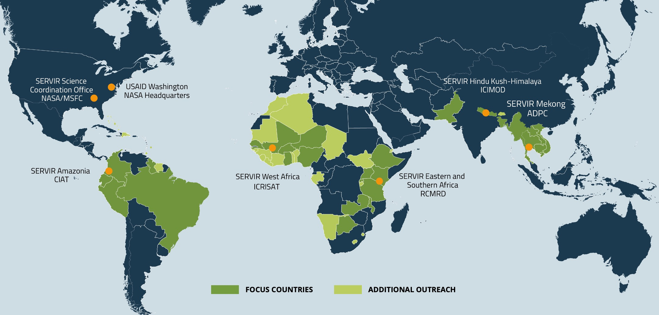
SERVIR Focuses Asia, Africa & the Americas

Slide 5
Who is SERVIR?

Slide 6
What Makes SERVIR Unique?

Slide 7
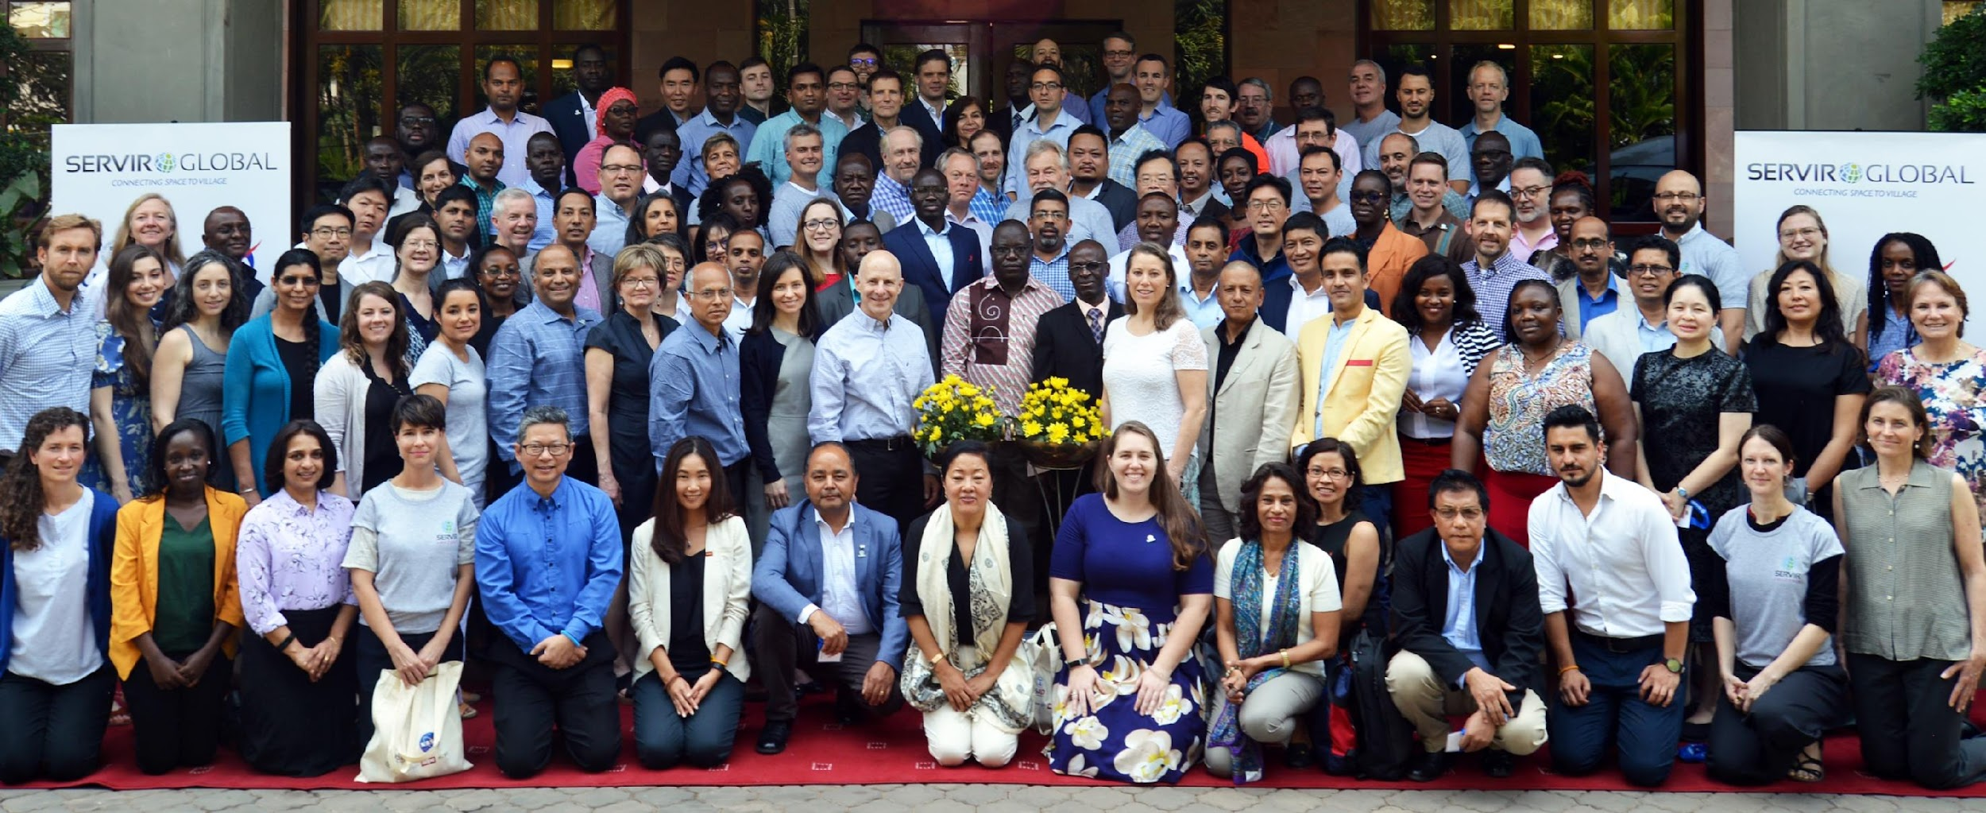
Distinctive Aspects of SERVIR
Power and Depth of the SERVIR Network
Scaling, Sharing, and Replicating
Integrates and Acts on Gender Inclusion
^{Open Approach and Open Science}

Slide 8
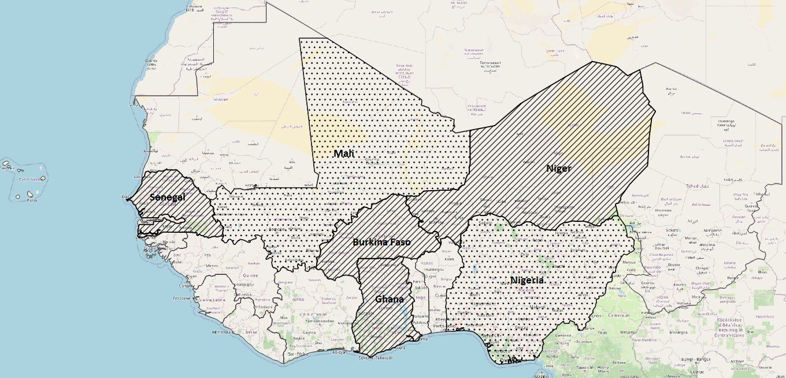
SERVIR West Africa
Phase 1 :
4 pilot countries (Burkina Faso, Ghana, Niger and Senegal)
Phase 2 :
2 more countries:
(Mali, Nigeria)

Slide 9
SERVIR West Africa
Our Consortium

Slide 10
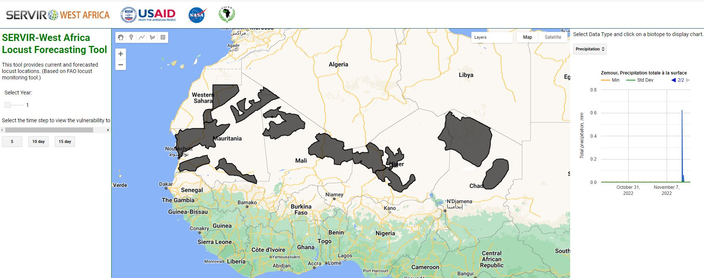
SERVIR West Africa: Agriculture and Food Security
Desert locust risk mapping : P-Locust
End Users: FAO/CLCPRO, CILSS/AGRHYMET, UNLA
In the Front Line Countries (Mauritania, Mali,Niger and Chad) Invasion countries (Senegal and Burkina Faso) and Maghreb
Prevent the Desert Locusts’ breakout

Slide 11
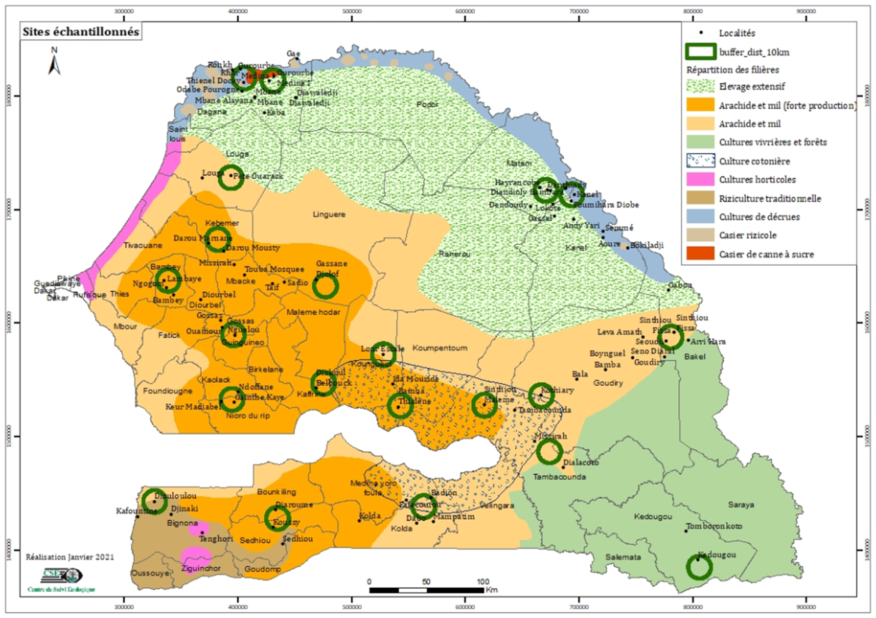
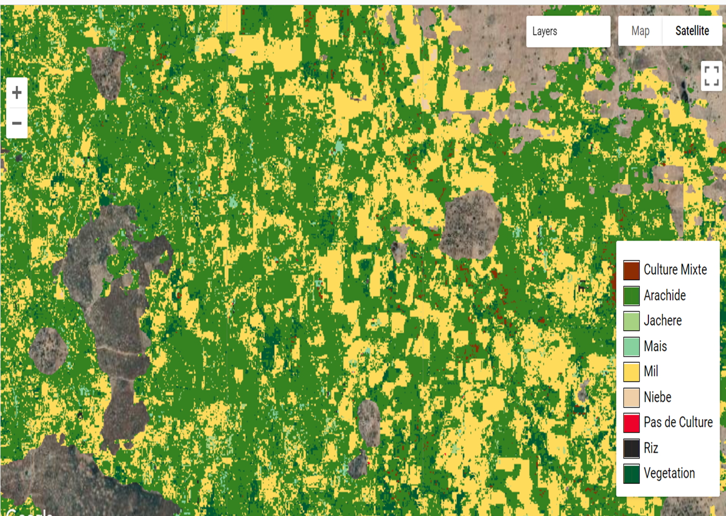
SERVIR West Africa: Agriculture and Food Security
Data collection
Crop types mapping

Slide 12
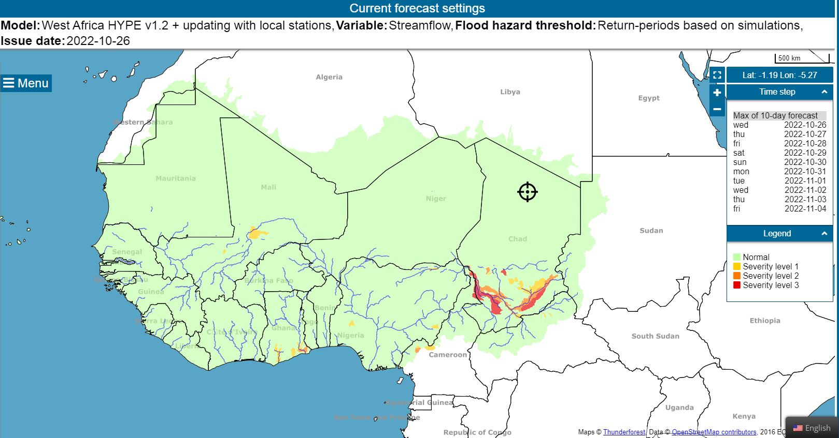
SERVIR West Africa: Water and Water related Disasters
Fash Flood
Socio economic data
https://fanfar.eu/ivp/
Chad declares state of emergency with one million affected by floods

Slide 13
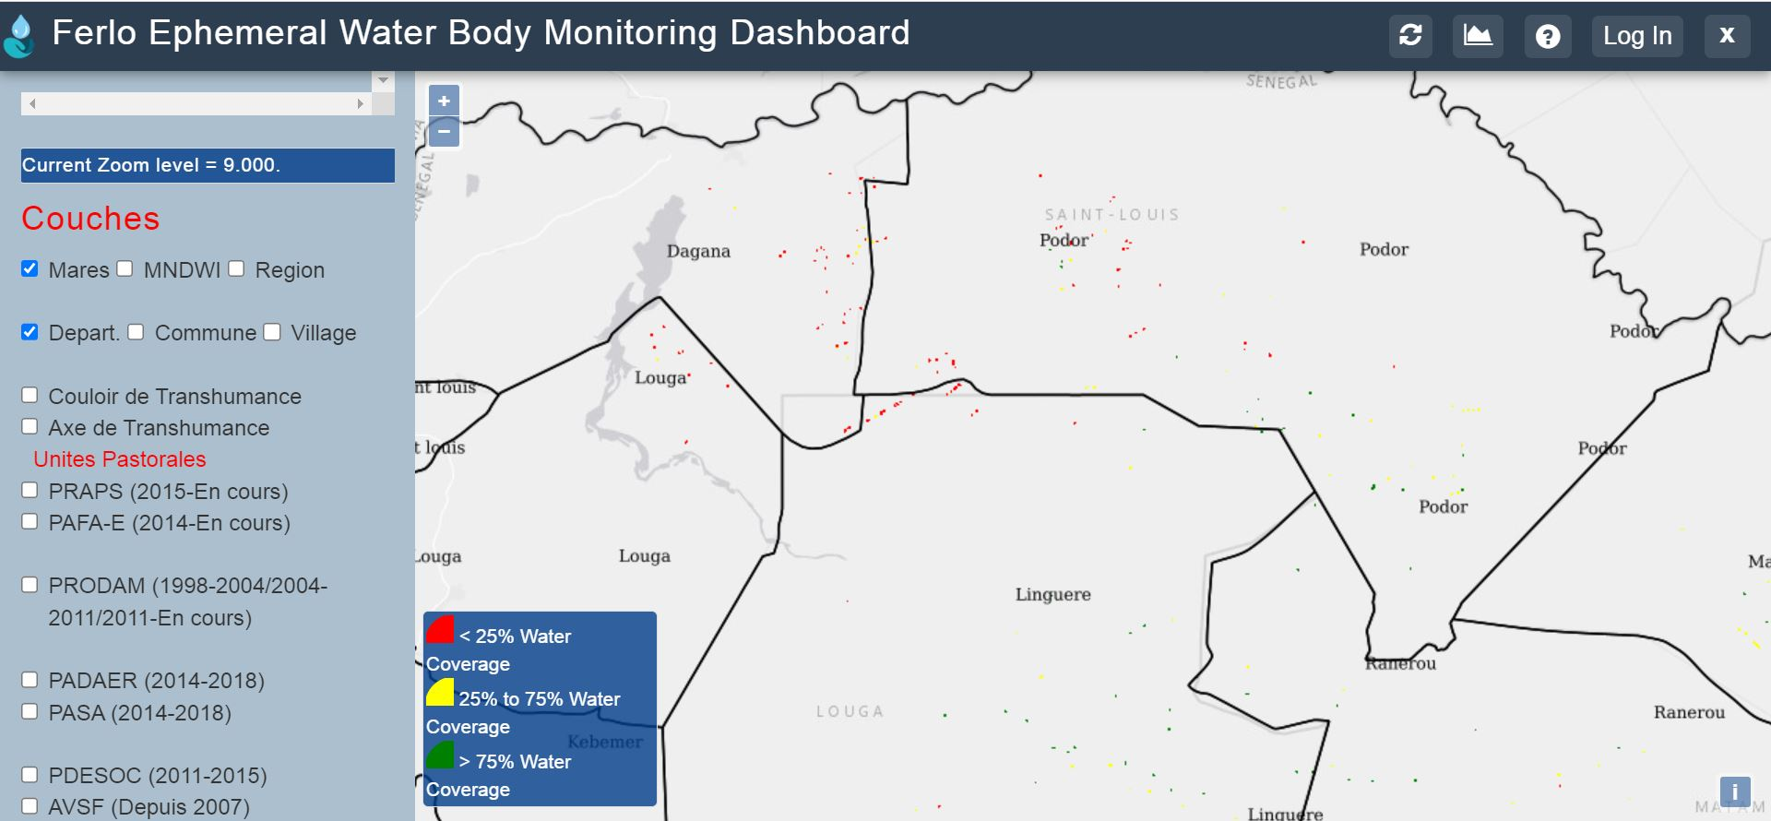
SERVIR West Africa: Water and Water related Disasters
Monitoring ephemeral water bodies , in the Ferlo (Senegal)
https://apps.servirglobal.net/apps/waterwatch/

Slide 14
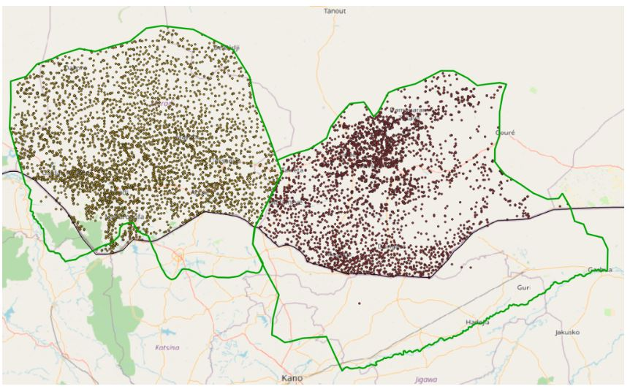
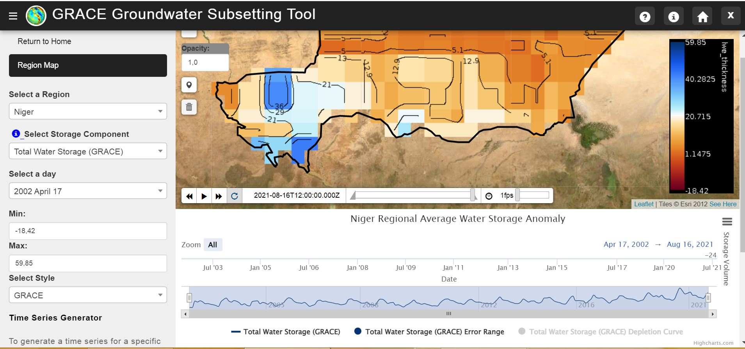
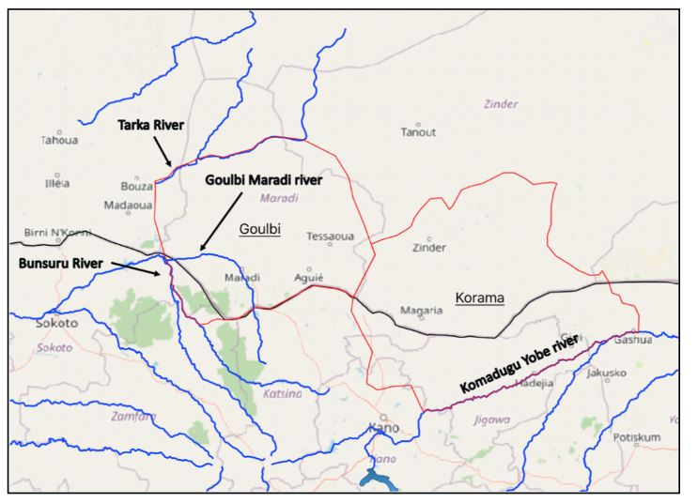
SERVIR West Africa: Water and Water related Disasters
Groundwater monitoring in Niger
Analyse changes in water tables and caraterize aquifer storage over time

Slide 15
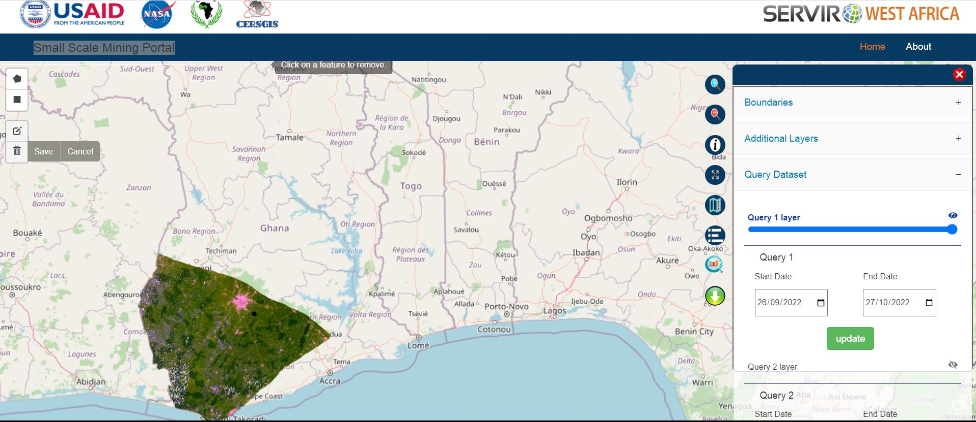
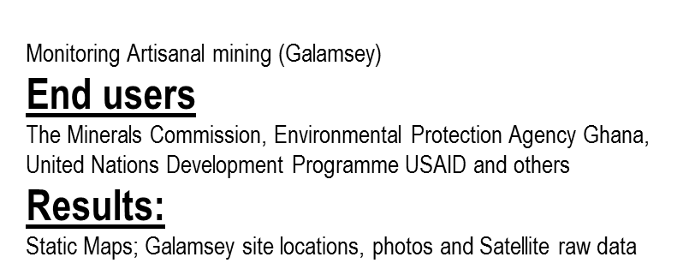
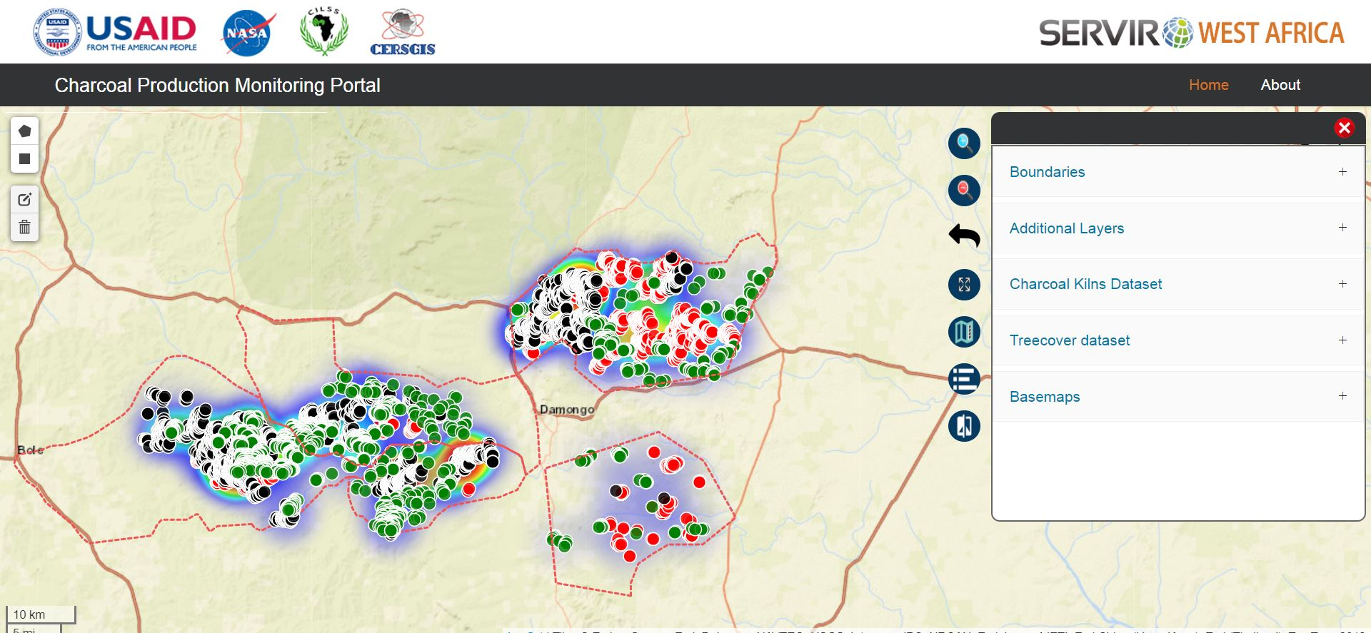
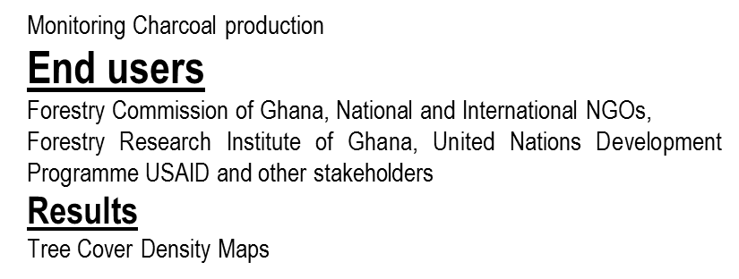
SERVIR West Africa: Land Use Land Cover Change & Ecosystems
http://servir.cersgis.org/

Slide 16
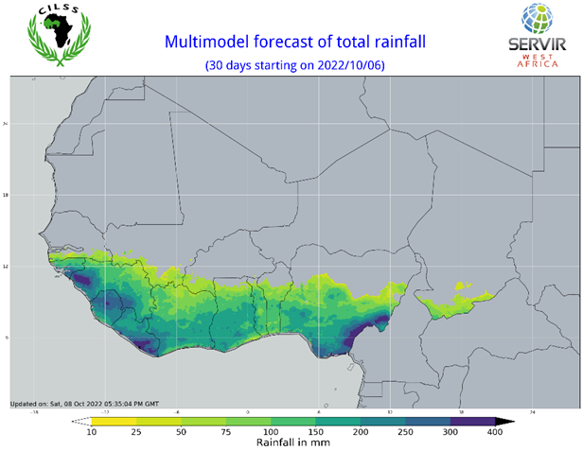
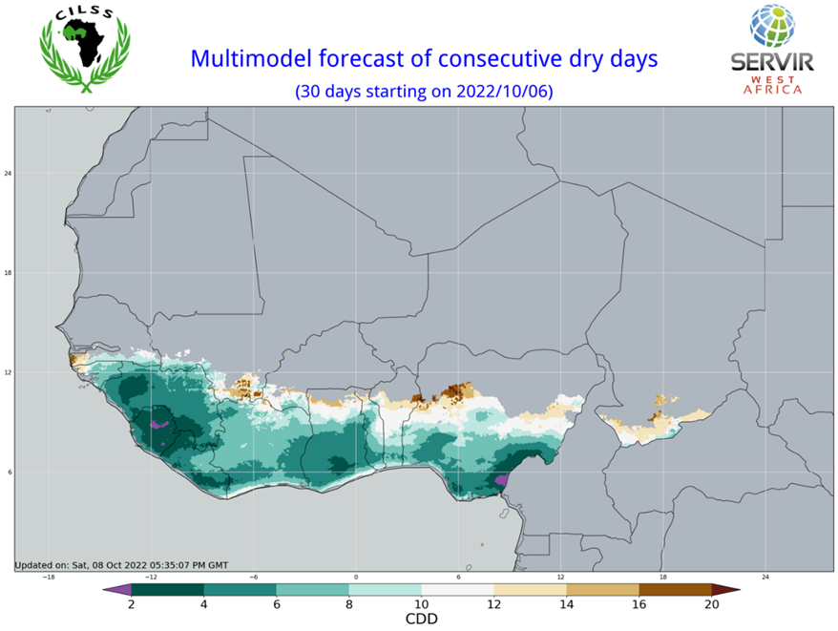
SERVIR West Africa: Weather and Climate
Outlook for the duration of monthly dry spells for the period October 6 to November 5, 2022
Outlook for monthly rainfall totals for the period October 6 to
November 5, 2022

Slide 17
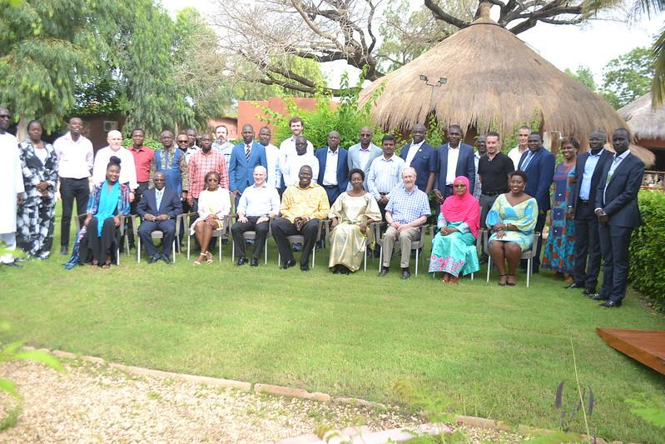
SERVIR West Africa

Slide 18
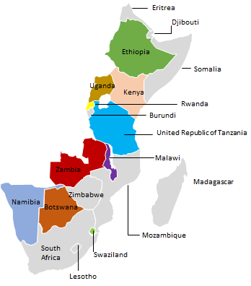
SERVIR Eastern & Southern Africa (E&SA)

Slide 19
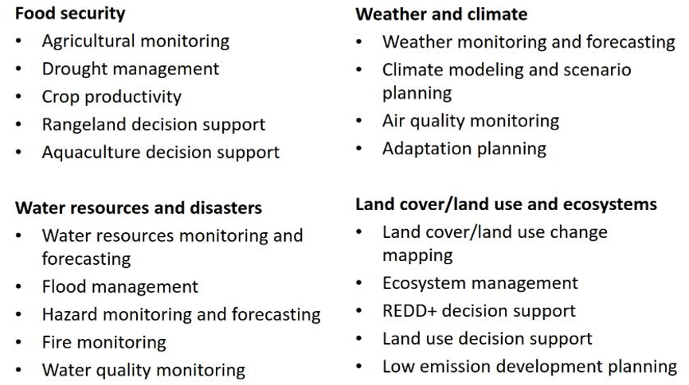
SERVIR E&SA Services
01
Agriculture & Food Security
02
Land Use Land Cover Change
03
Water & related Disasters
04
Weather & Climate

Slide 20
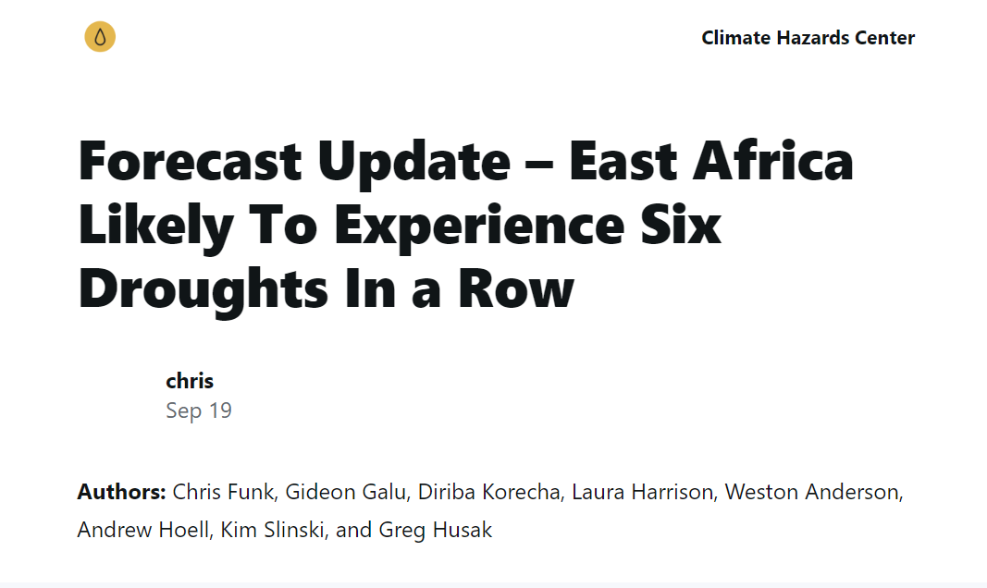
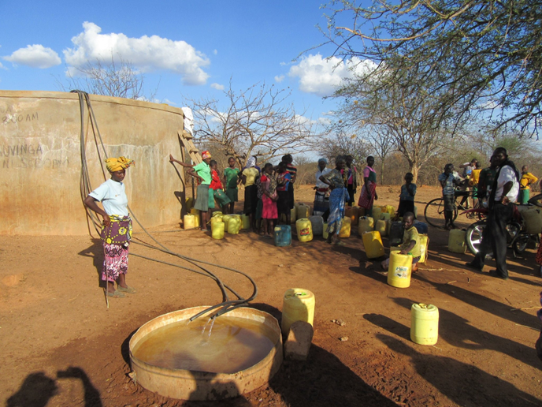
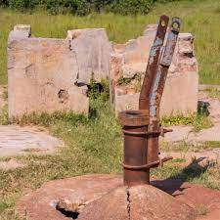
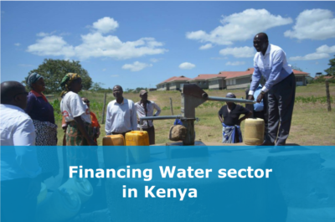
SERVIR E&SA: 1) Borehole Water Monitoring
Non-Functionality of EDE boreholes
Inadequate Funds for Borehole Repair

Slide 21
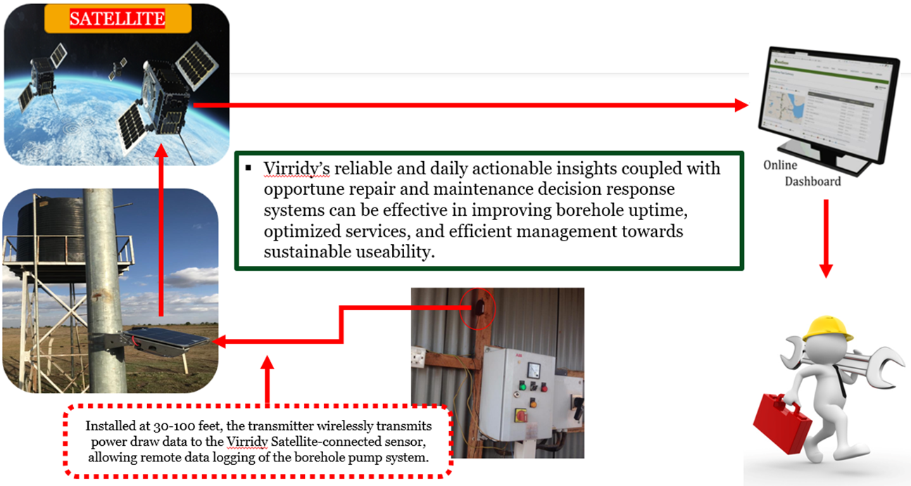
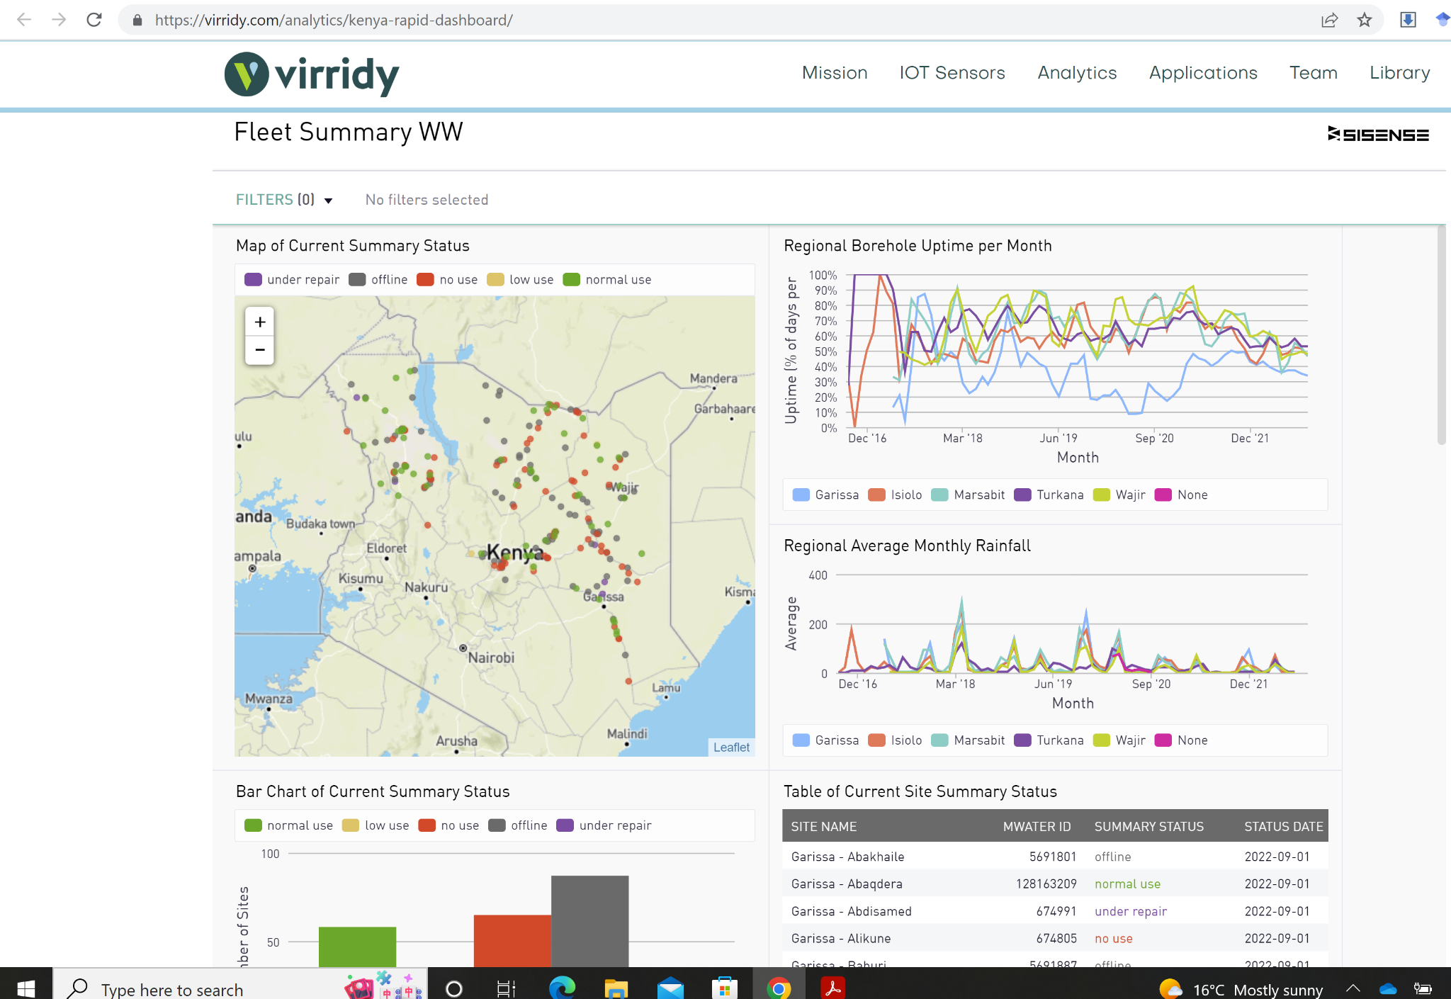
SERVIR E&SA: 1) Borehole Water Monitoring
https://virridy.com/analytics/kenya-rapid-dashboard/

Slide 22
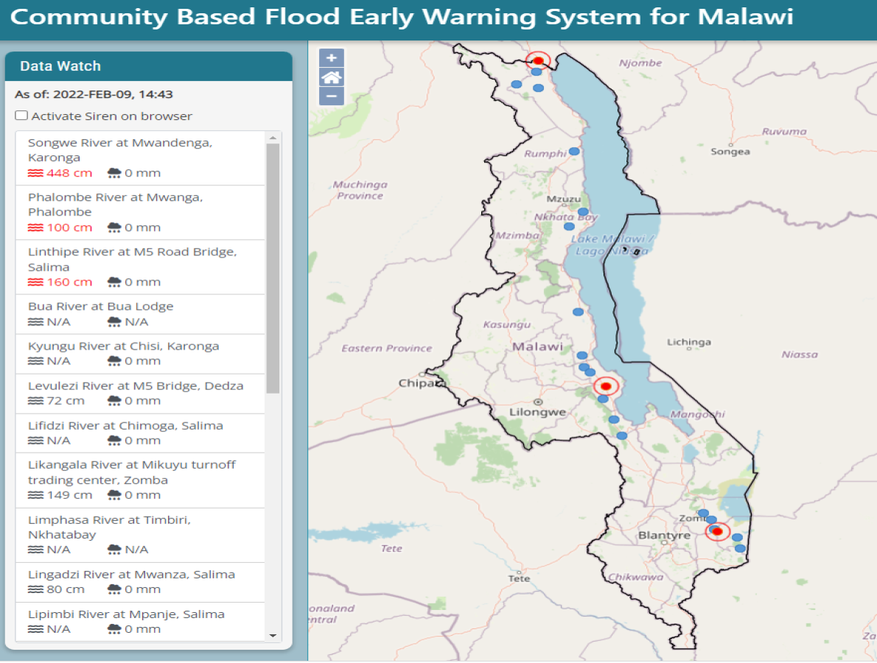
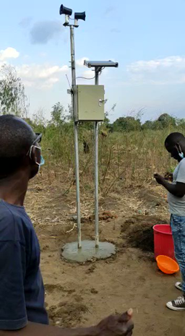
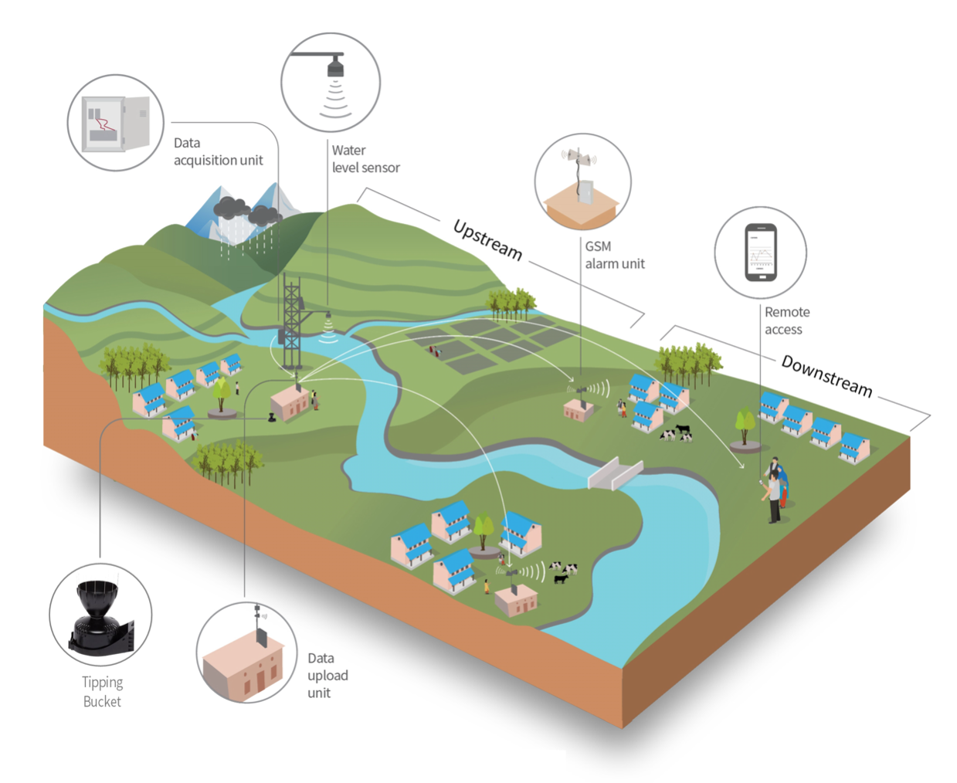
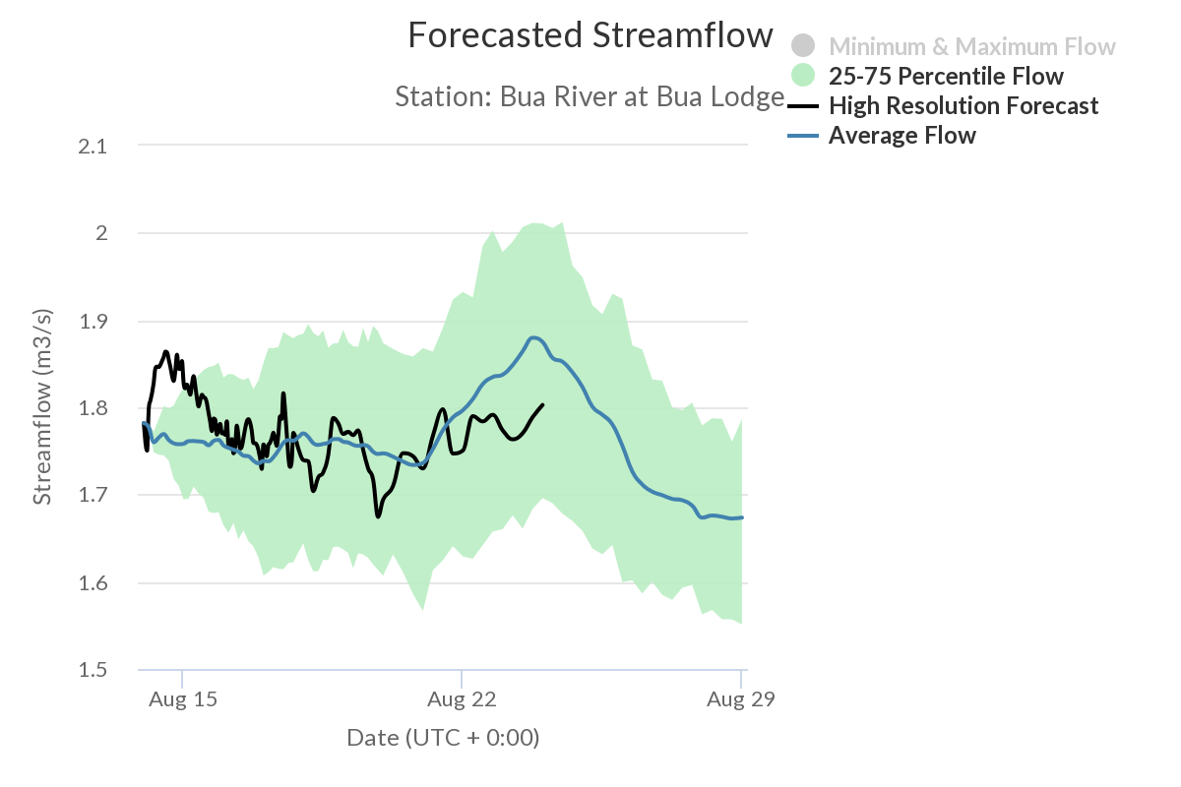
SERVIR E&SA: 2) Flood Early Warning System
Malawi Community Based flood early warning system (CBFEWS)

Slide 23
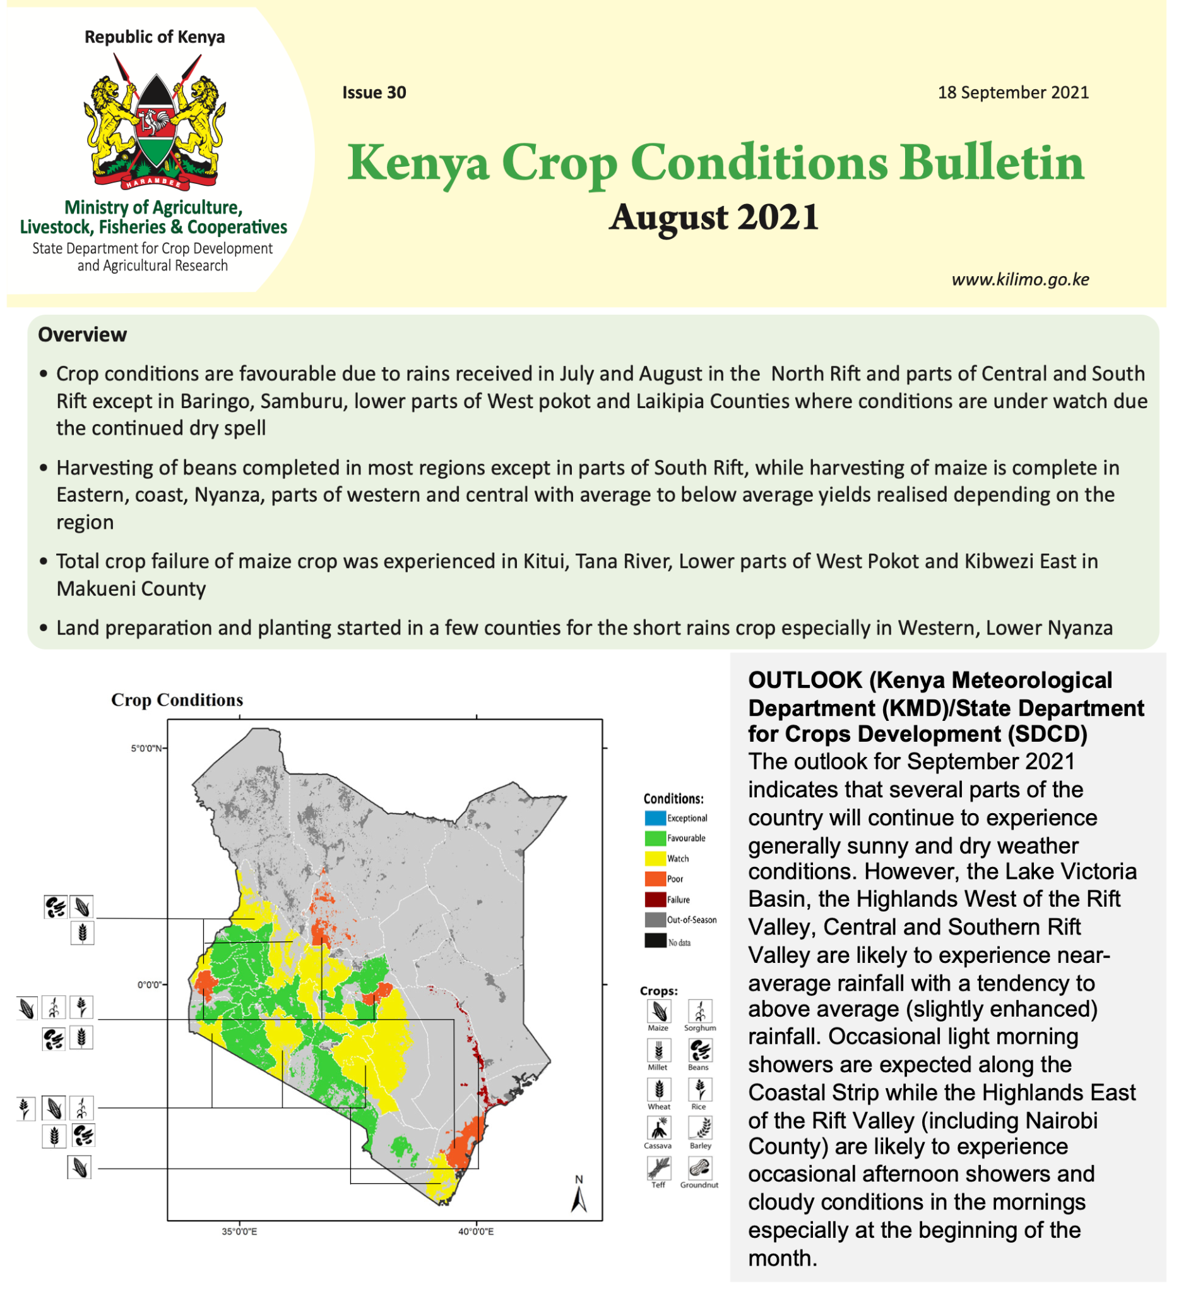
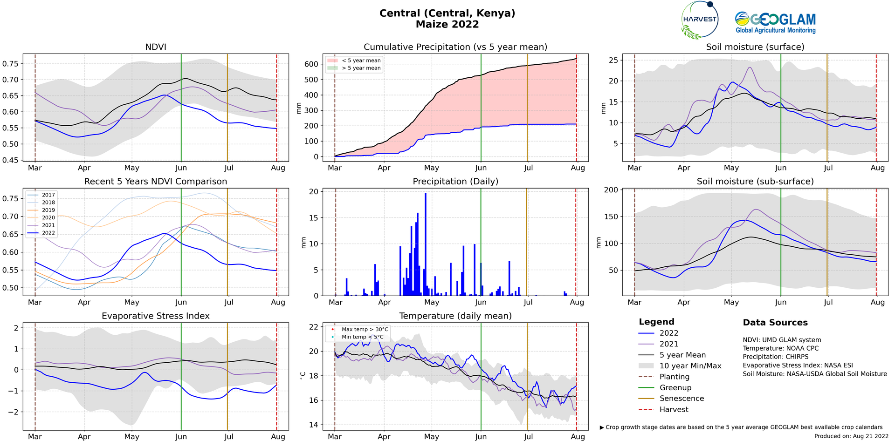
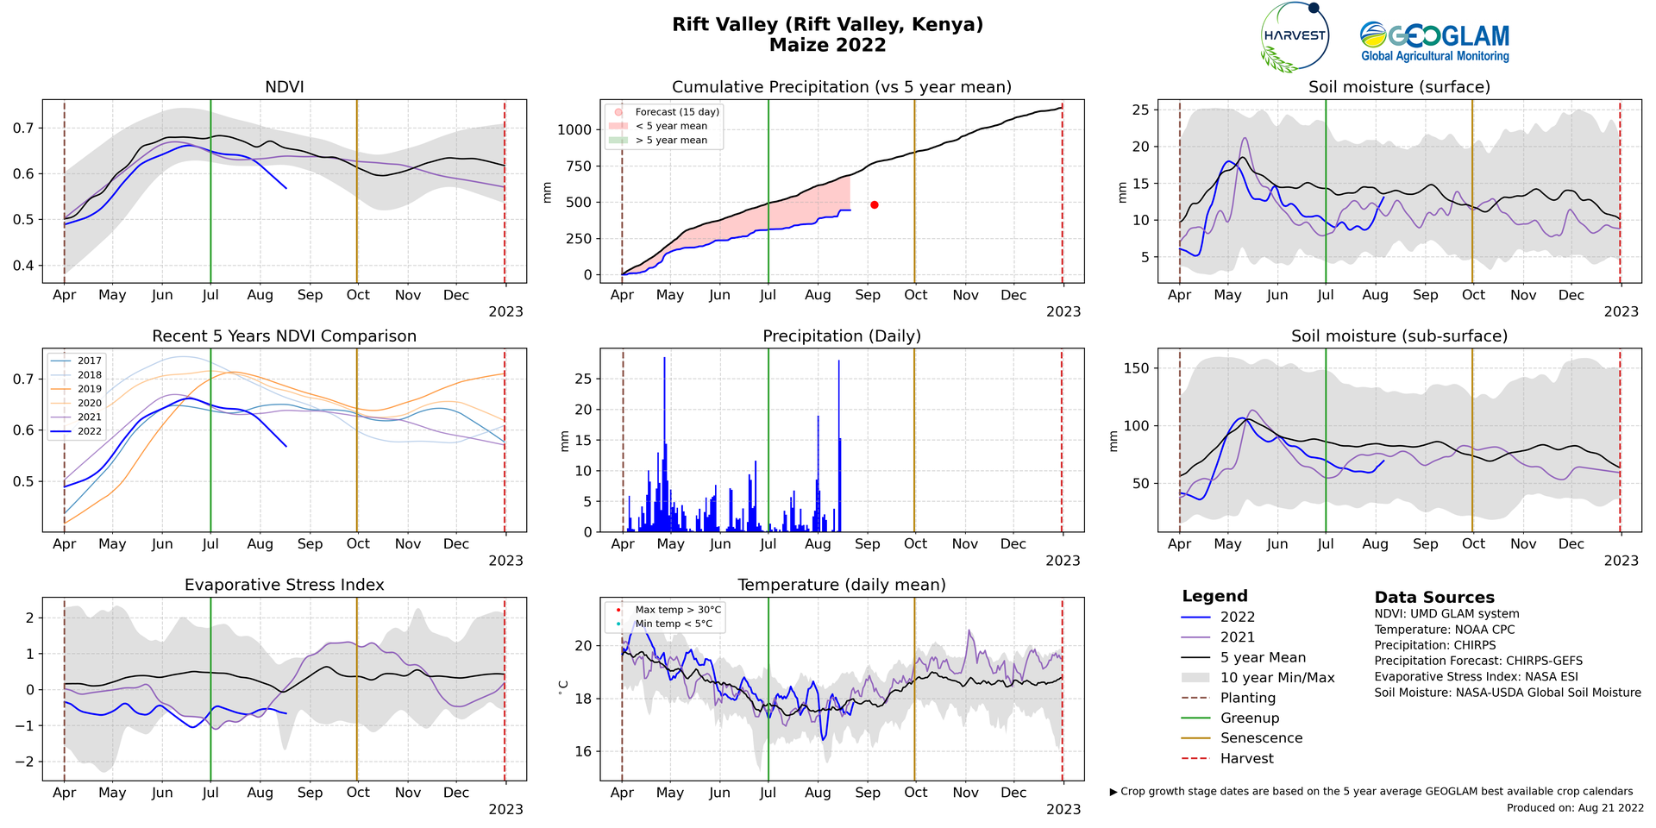
SERVIR E&SA: 3) Crop Conditions & Yield Forecasts
National Crop Monitors
The Agrometeorological (AGMET) Earth Observations (EO) Indicators bring together a variety of Earth Observation (EO) data products on the sub-national scale, each of which provides valuable insights on in-season crop development and current crop conditions.
Improving monitoring and early warning systems that provide actionable data and information on agricultural productivity and food security at multiple scales

Slide 24
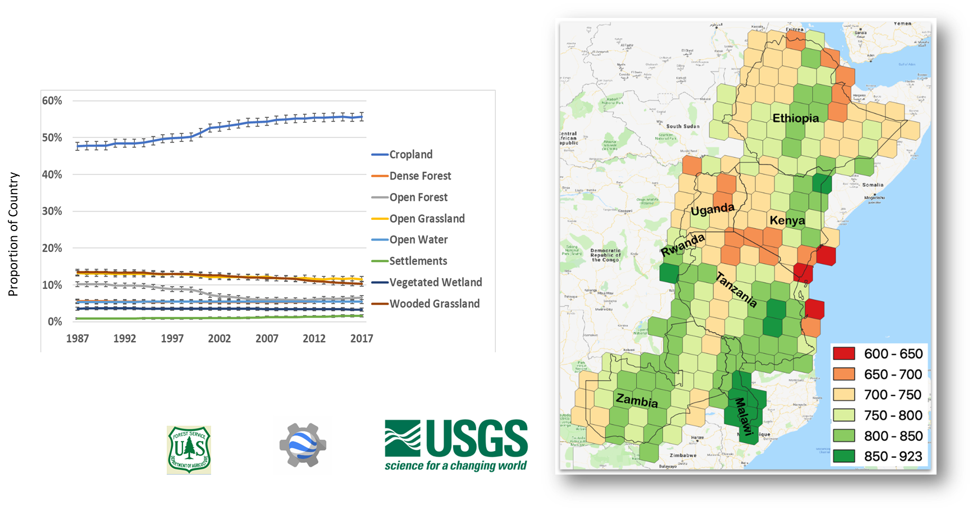
SERVIR E&SA: 4) Land Cover Mapping, GHG, Natural Capital Accounting

Slide 25
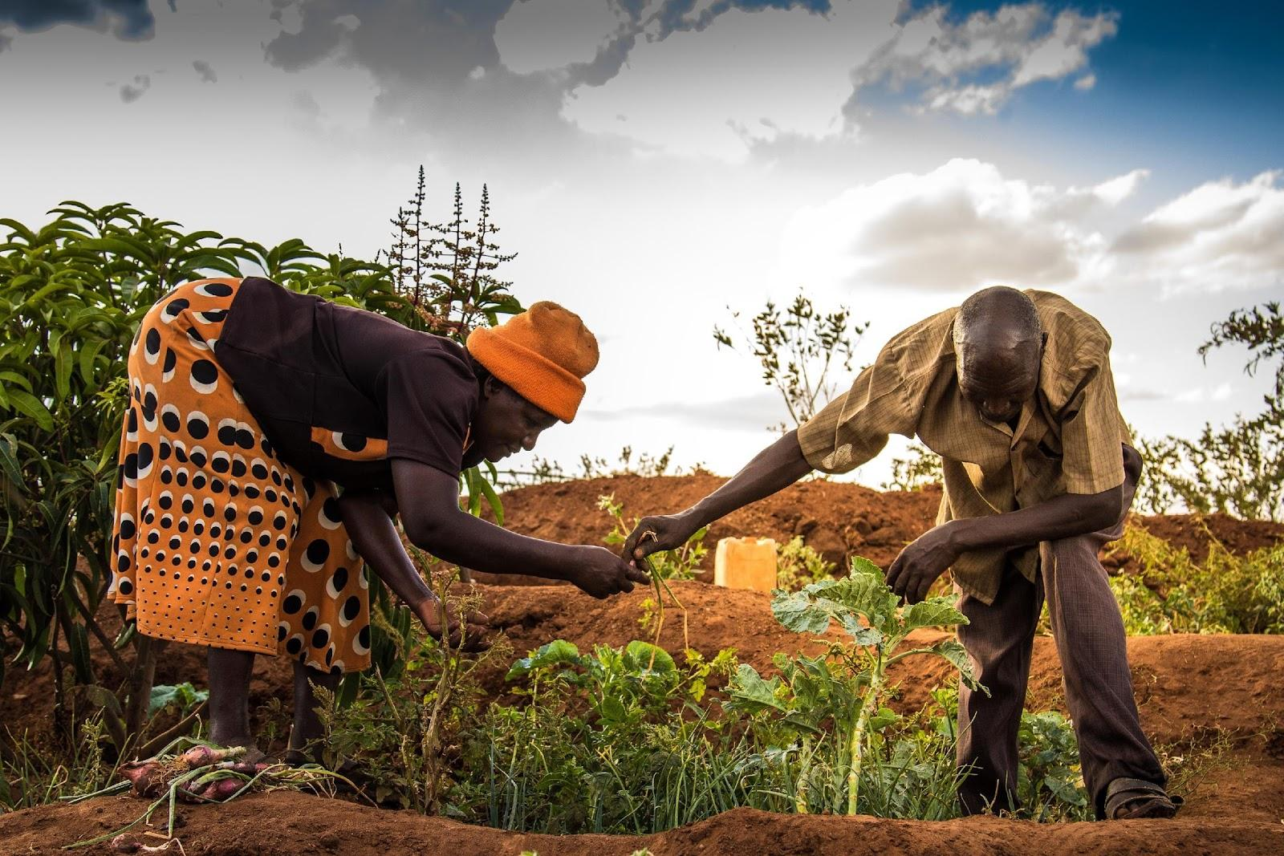
SERVIR E&SA: 5) Risk Financing & Index Insurance
Gender-sensitive Agricultural Index-based INSurance (GAIINS)
Eastern & Southern Africa
Quality certification (QUIIC) - UCDavis, RCMRD/SERVIR, JKUAT
Designed to revolutionize how we assess index insurance products’ safety (minimum quality standard) while efficiently communicating product quality to smallholder farmers
Pilots with insurance companies and consortia in Mozambique, Uganda
Kenya Crop Insurance Program - RCMRD/SERVIR
RCMRD/SERVIR helped reduce the cost of Kenya crop insurance assessments by 70%, enabling an expansion to cover 425,000 farmers.
12,000 farmers were compensated in 2019 to offset losses
Livestock insurance - identifying thresholds for early action - RCMRD/SERVIR
Sub-county tool for National Drought Mgmt Authority in Kenya and NGOs
Global
EO-based services on flood, fire, drought, severe weather
Technical Assessment Group on Risk Financing & Earth Obs - SERVIR-wide
External expert assessment of risk financing and Earth observations for SERVIR
Strong recommendations to expand and deepen QUIIC-like activities

Slide 26
Thank you
Questions?

